Slide 1
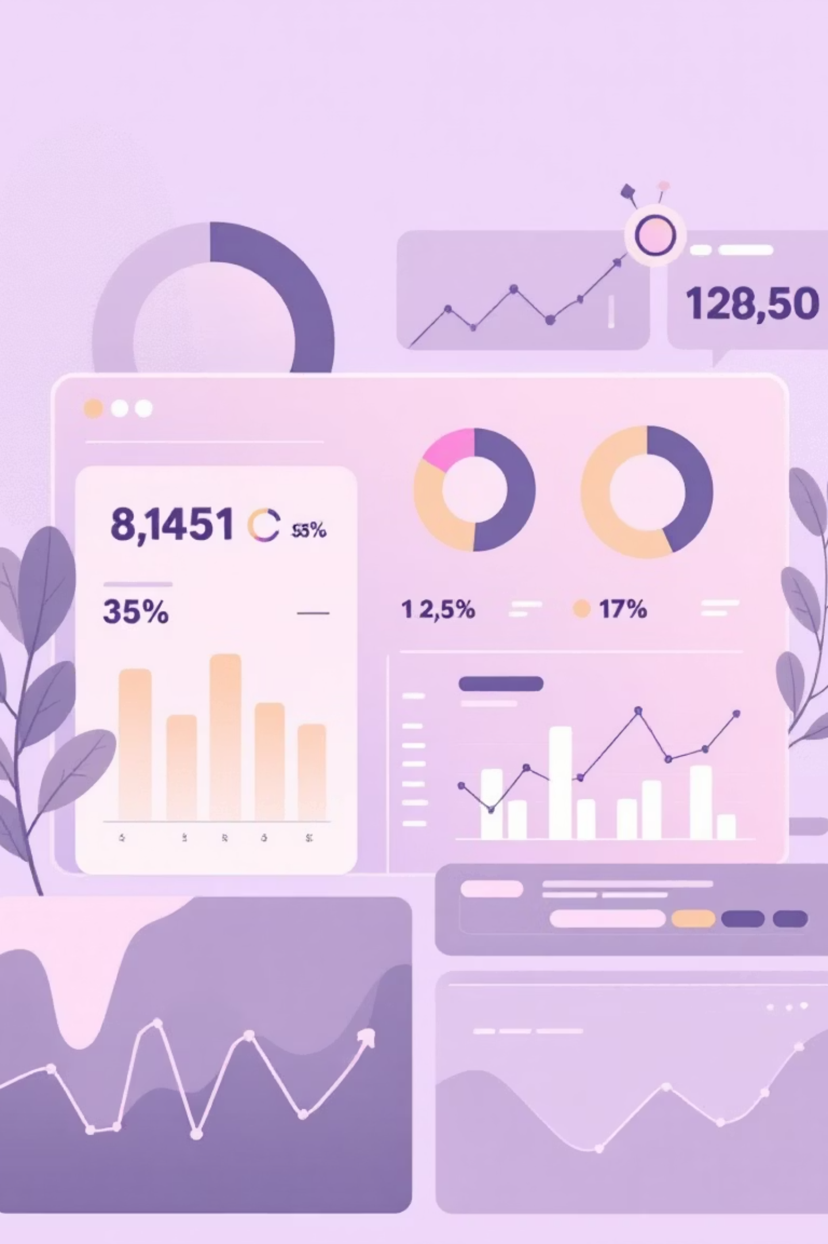
Customer Shopping Behavior Analysis
Uncovering insights from 3,900 purchases to drive strategic business decisions

Slide 2
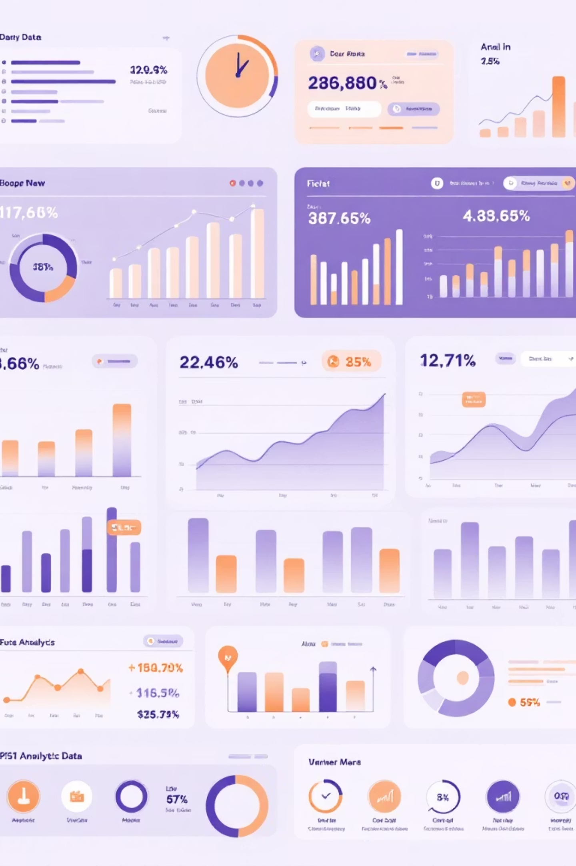
Dataset Overview
3,900
18
50
Total Purchases
Data Columns
Locations
Transactions analyzed across all categories
Comprehensive customer and purchase attributes
Geographic diversity in customer base
25
Product Types
Wide variety of items purchased

Slide 3
Data Preparation & Cleaning
01
02
Data Loading
Missing Data Handling
Imported dataset using pandas, explored structure with df.info() and summary statistics
Imputed 37 missing Review Rating values using median rating per product category
03
04
Feature Engineering
Database Integration
Created age_group and purchase_frequency_days columns for deeper analysis
Connected to PostgreSQL and loaded cleaned data for SQL analysis

Slide 4
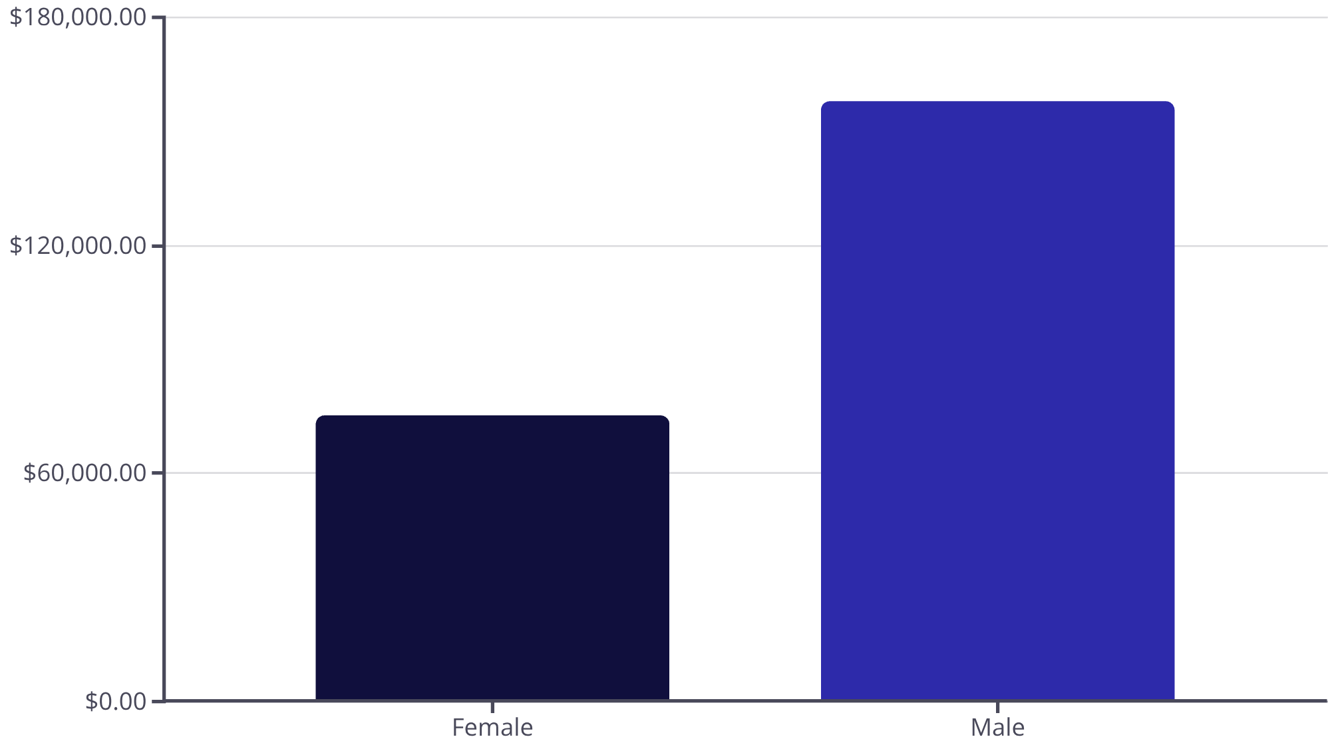
Revenue by Gender
Key Insight
Male customers generate 2.1x more revenue than female customers
Total revenue: $233,081

Slide 5
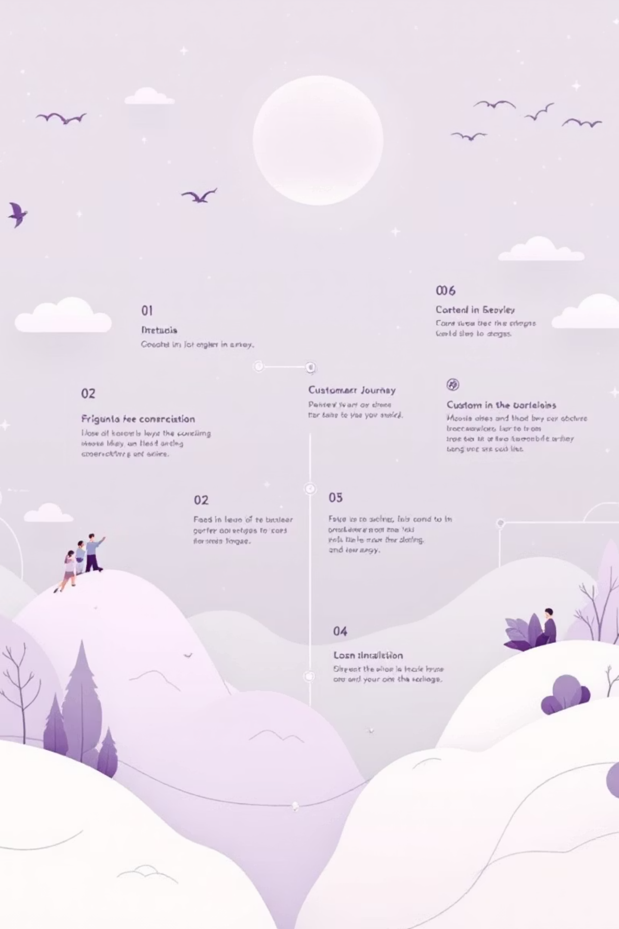

Customer Segmentation Analysis
Loyal Customers
Returning Buyers
3,116 customers
701 customers
Largest segment driving repeat business
Growth opportunity segment
New Customers
83 customers
Fresh acquisition potential
80% of customers are in the Loyal segment, indicating strong retention

Slide 6

Top-Rated Products
1
2
3
Gloves
Sandals
Boots
Average rating: 3.86
Average rating: 3.84
Average rating: 3.82
4
5
Hat
Skirt
Average rating: 3.80
Average rating: 3.78

Slide 7
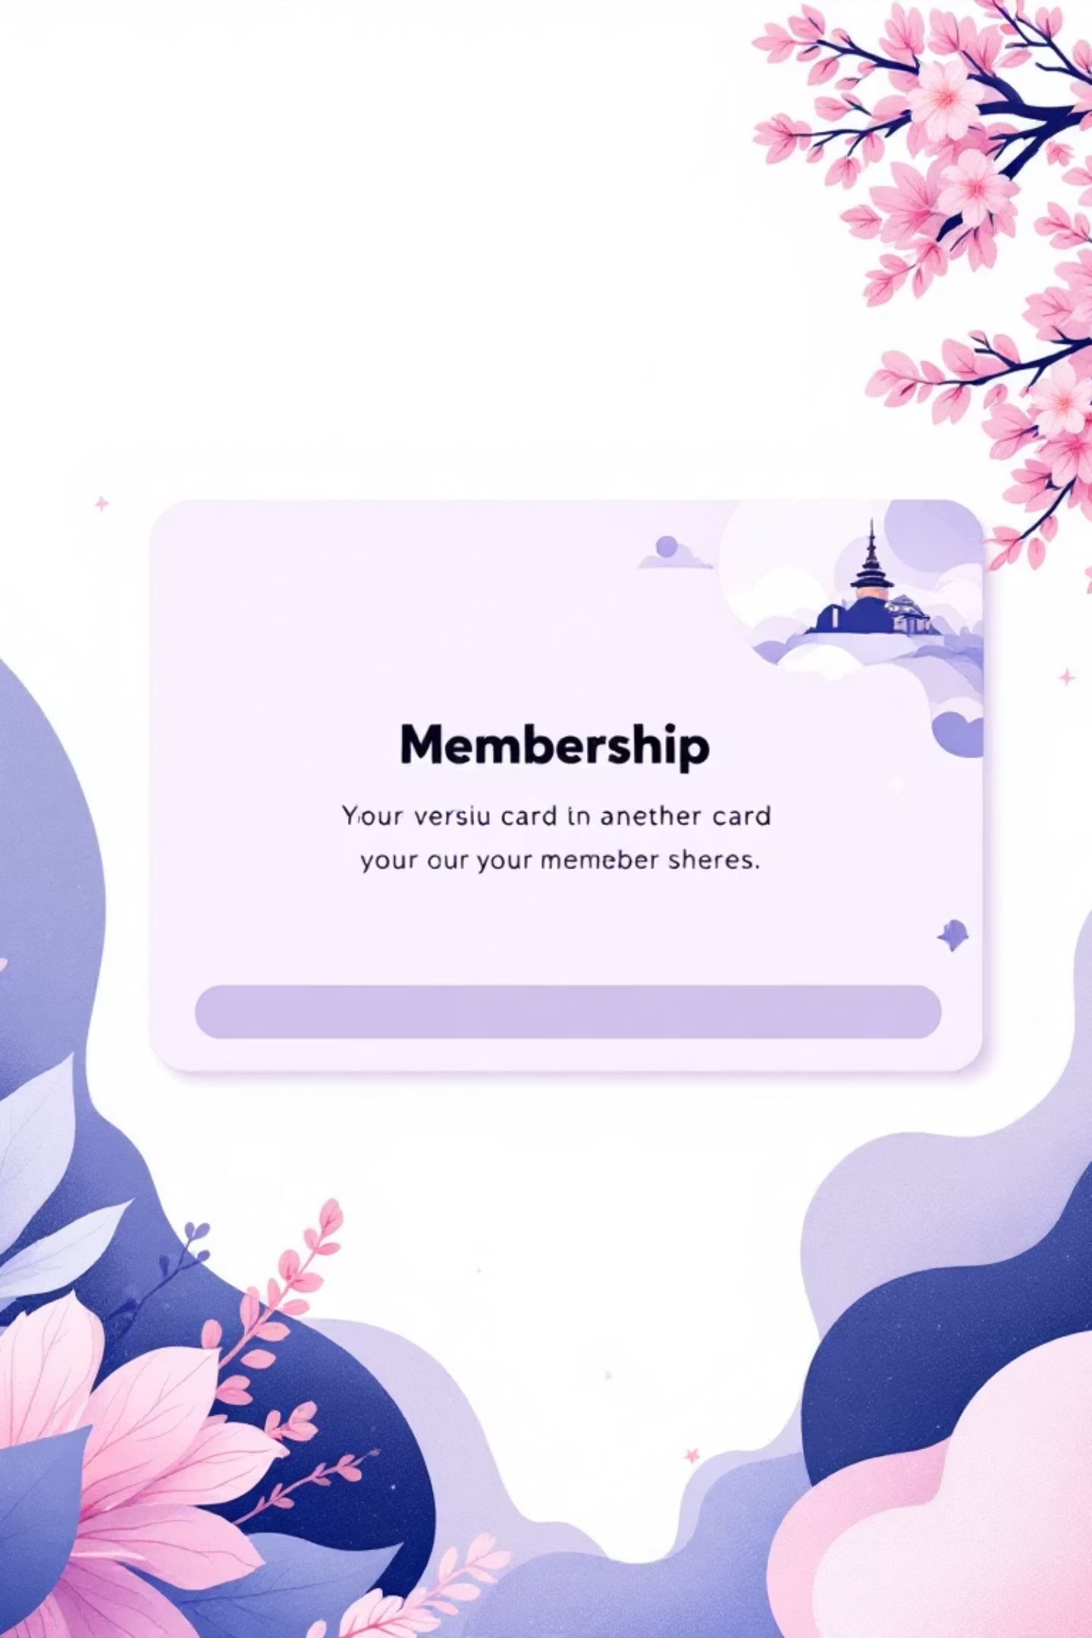
Subscription Impact
Subscribers
Non-Subscribers
1,053 customers
2,847 customers
Average spend: $59.49
Average spend: $59.87
Total revenue: $62,645
Total revenue: $170,436
Repeat buyers with 5+ purchases: 958 subscribers vs 2,518 non-subscribers

Slide 8
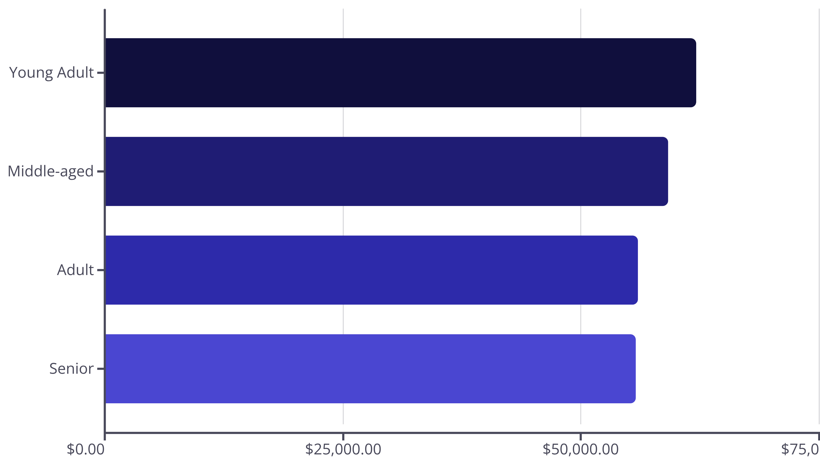
Revenue by Age Group
Young adults lead revenue generation, followed closely by middle-aged customers

Slide 9
Discount & Shipping Insights
High-Value Discount Users
Shipping Preferences
Discount-Dependent Products
839 customers used discounts but spent above average
Express: $60.48 avg vs Standard: $58.46 avg
Hats lead at 50% discount rate, followed by Sneakers at 49.66%

Slide 10






Strategic Recommendations
Boost Subscriptions
Loyalty Programs
Targeted Marketing
Promote exclusive benefits to convert high-frequency buyers
Reward repeat buyers to strengthen the loyal segment
Focus on young adults and express-shipping users
Product Positioning
Review Discount Policy
Highlight top-rated items in marketing campaigns
Balance sales growth with margin control

